Slide 1
Pursue

Slide 2
Add the prefixes, suffixes, related words, and your best guess at the definition (don’t forget to include context clues)
The dog pursued the mailman relentlessly, chasing him over a fence.
In pursuit of higher education, Megan took out several loans so she could follow her dreams.
The cat was pursuing the mouse across the kitchen floor, but it ran away.
Although Jeremy wanted to play in the NBA, he realized he needed to set more pursuable goals.

Slide 3
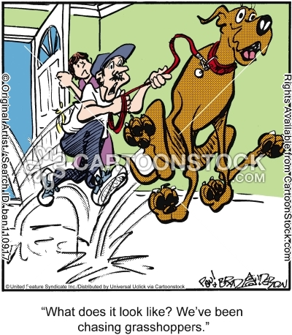
When someone is pursuing something, are they casually going after it, or do you think they are chasing it vigorously?

Slide 4
When someone is pursuing something, are they casually going after it, or really chasing it down?

