Slide 1
inspect

Slide 2
1. My father inspected our rooms with a white glove to check for dust.
2. My mother inspects everything for dirt and dust.
3. When we bought a used car, we had a mechanic perform an inspection of the engine and body to find out if there was anything wrong with it.
4. The health inspector condemned the restaurant after finding gum in his dinner, a hair in his dessert, and a mouse under the table.

Slide 3
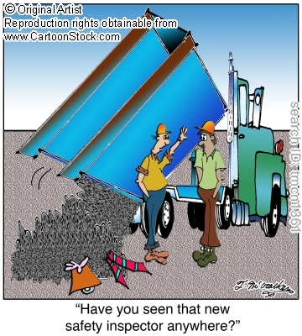

Slide 4
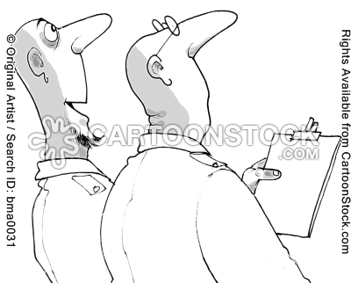
What occupations need to inspect something?

