Slide 1
Document
The student documented all his research carefully so he didn’t plagiarize—his readers need to be able to find his sources.
Undocumented research is sometimes useless because there is no record of the experiment or results.
Without documentation, the traveler was not allowed in the country because he couldn’t prove his identity.
The documentary showed the lifestyles of the native tribes in New Guinea.
The Declaration of Independence is a very, very old document.

Slide 2
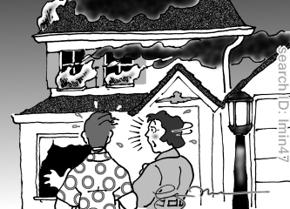
I’m so glad you put our insurance policy in the safe-deposit box!

Slide 3
What are some important documents that you would never want to lose?

Slide 4
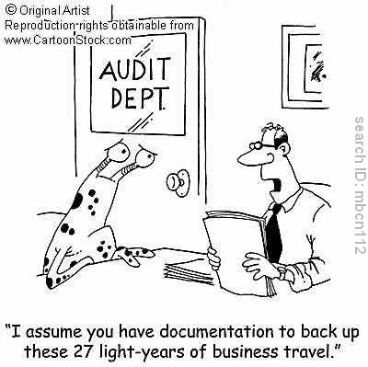
I assume you have documentation to prove these 27 light years of business travel?

Slide 5
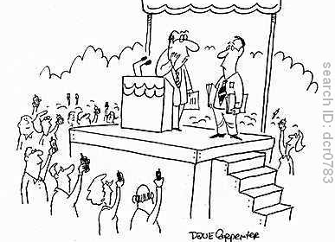
With all these video-phones, there’s just too much documentation of all my campaign promises!

Slide 6
What is the purpose of having a lot of documentation?

Slide 7
Grant
The teacher granted the student permission to leave the room.
The president has the ability to grant pardons.
Sometimes we take the things we have in life for granted.
After applying for many, many grants, the researcher was finally able to fund his studies.

Slide 8
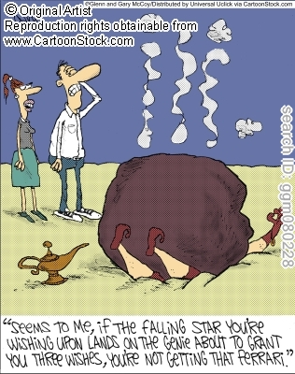
Seems to me that if the falling star you’re wishing upon lands on the genie about to give you three wishes, you aren’t getting that Ferrari.

Slide 9
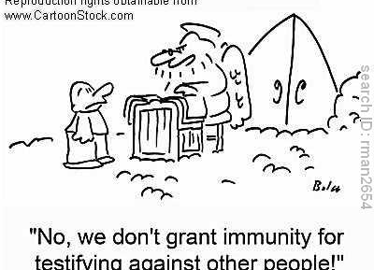

Slide 10
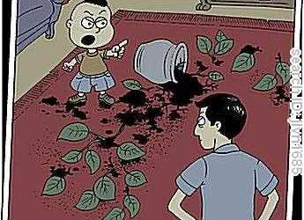
You resent me for exploring in depth a world you take for granted…

Slide 11
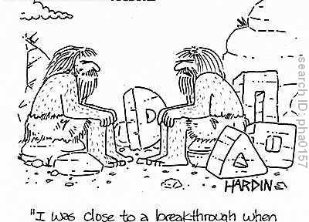
I was close to a break-though when my grant money ran out.

